Slide 1
Joining Tables

Slide 2
Lecture Outline
Joining Tables Background
Different types of JOINs
OUTER Joins
Hierarchical Joins
Oracle Specific Joins

Slide 3
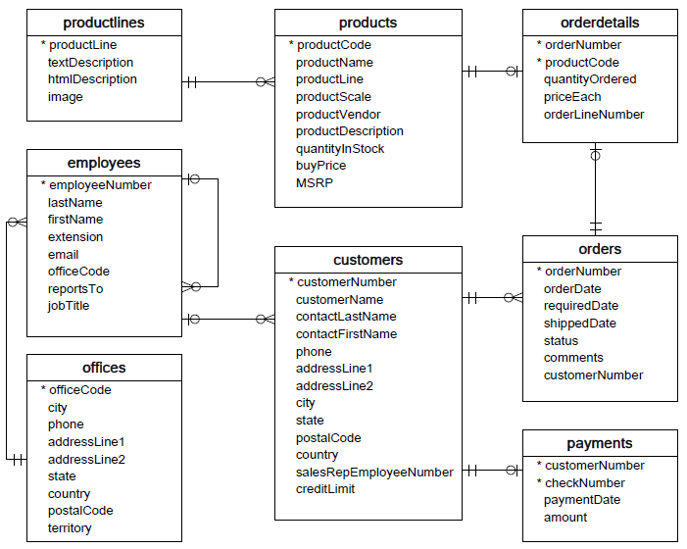
Joins Background
Up to now, your experience using SQL has been limited to querying and returning information from one database table at a time.
This would not be a problem if all data in the database were stored in only one table.
But you know from data modeling that separating data into individual tables and being able to associate the tables with one another is the heart of relational database design
Fortunately, SQL provides join conditions that enable information to be queried from separate tables and combined in one report.

Slide 4
Join Commands
There are two sets of commands or syntax which can be used to make connections between tables in a database:
Oracle proprietary joins
ANSI/ISO SQL 99 compliant standard joins. ANSI stands for American National Standards Institute

Slide 5
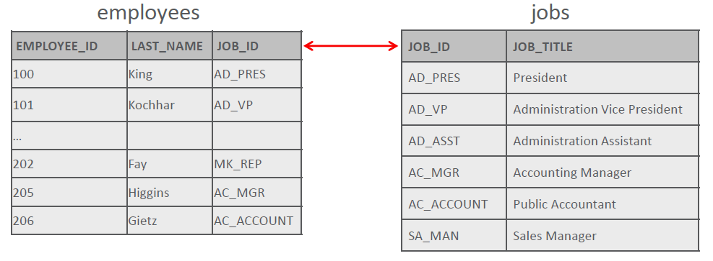
Natural Join
SQL join clause combines fields from 2 (or more) tables in a relational database.
A natural join is based on all columns in two tables that have the same name and selects rows from the two tables that have equal values in all matched columns.
The employees table has a job_id column, this is a reference to the column of the same name in the jobs table.

Slide 6
Natural Join
As shown in the sample code, when using a natural join, it is possible to join the tables without having to explicitly specify the columns in the corresponding table.
However, the names and data types of both columns must be the same.
This join will return columns from the employees table and their related job_title from the jobs table based on the common column job_id.
SELECT first_name, last_name, job_id, job_title
FROM employees NATURAL JOIN jobs
WHERE department_id > 80;

Slide 7
Natural Join
Here is another example:
The departments and locations table both have a column, location_id, which is used to join the two tables.
Notice that the natural join column does not have to appear in the SELECT clause.
SELECT department_name, city
FROM departments NATURAL JOIN locations;
DEPARTMENT_NAME | CITY
Marketing | Toronto
Sales | Oxford
IT | Seattle
Shipping | Seattle

Slide 8
CROSS JOIN
SQL CROSS JOIN joins each row in one table to every row in the other table.
The result set represents all possible row combinations from the two tables.
This could potentially be very large!
If you CROSS JOIN a table with 20 rows with a table with 100 rows, the query will return 2000 rows.
The employees table contains 20 rows and the departments table has 8 rows. Performing the CROSS JOIN will return 160 rows.
SELECT last_name, department_name
FROM employees CROSS JOIN departments;
LAST_NAME | DEPARTMENT_NAME
Abel | Administration
Davies | Administration
Fay | Administration
Singh | Administration

Slide 9
Joins with USING
In a natural join, if the tables have columns with the same names but different data types, the join causes an error.
To avoid this situation, the join clause can be modified with a USING clause.
The USING clause specifies the columns that should be used for the join.

Slide 10
USING Clause Example
The query shown is an example of the USING clause.
The columns referenced in the USING clause should not have a qualifier (table name or alias) anywhere in the SQL statement.
SELECT first_name, last_name, department_id, department_name
FROM employees JOIN departments USING (department_id);
FIRST_NAME | LAST_NAME | DEPARTMENT_ID | DEPARTMENT_NAME
Jennifer | Whalen | 10 | Adminstration
Michael | Smith | 20 | Marketing
Paul | Singh | 20 | Marketing
… | … | … | …

Slide 11
USING Clause Another Example
The USING clause allows us to use WHERE to restrict rows from one or both tables:
SELECT first_name, last_name, department_id, department_name
FROM employees JOIN departments USING (department_id)
WHERE last_name = ‘Higgins’;
FIRST_NAME | LAST_NAME | DEPARTMENT_ID | DEPARTMENT_NAME
Jenn | Higgins | 110 | Accounting

Slide 12
Aliases
Working with lengthy column and table names can be cumbersome.
Fortunately, there is a way to shorten the syntax using aliases.
To distinguish columns that have identical names but reside in different tables, use table aliases.
A table alias is similar to a column alias; it renames an object within a statement.
It is created by entering the new name for the table just after the table name in the from-clause.

Slide 13
Table Aliases Example
Table aliases are used in the query below:
When column names are not duplicated between two tables, you do not need to add the table name or alias to the column name
SELECT last_name, e.job_id, job_title
FROM employees e, jobs j
WHERE e.job_id = j.job_id AND department_id = 80;
LAST_NAME | JOB_ID | JOB_TITLE
Jenn | SA_MAN | Sales Manager
Abel | SA_REP | Sales Representative
Tayler | SA_REP | Sales Representative

Slide 14
Joins with ON Clause
What if the columns to be joined have different names, or if the join uses non-equality comparison operators such as <, >, or BETWEEN ?
We can't use USING, so instead we use an ON clause.
This allows a greater variety of join conditions to be specified.
The ON clause also allows us to use WHERE to restrict rows from one or both tables.

Slide 15
Joins with ON Clause Example
In this example, the ON clause is used to join the employees table with the jobs table.
A join ON clause is required when the common columns have different names in the two tables.
LAST_NAME | JOB_TITLE
King | President
Kochhar | EVP
De Haan | SVP
Whalen | Sales Manager
Higgins | Sales Representative
SELECT last_name, job_title
FROM employees e JOIN jobs j
ON (e.job_id = j.job_id);
If columns have the same, you need a qualifier either on the table or alias

Slide 16
Joins with ON Clause Example
Here is the same query with a WHERE clause to restrict the rows selected.
SELECT last_name, job_title
FROM employees e JOIN jobs j
ON (e.job_id = j.job_id)
WHERE last_name LIKE 'H%';
LAST_NAME | JOB_TITLE
Higgins | Sales Representative

Slide 17
ON Clause with non-equality operator
Sometimes you may need to retrieve data from a table that has no corresponding column in another table.
Suppose we want to know the grade_level for each employees salary.
The job_grades table doesn’t have a common column with the employees table.
Using an ON clause allows us to join the two tables
GRADE_LEVEL | LOWEST_SAL | HIGHEST_SAL
A | 1000 | 2999
B | 3000 | 5999
C | 6000 | 9999
D | 10000 | 14999
E | 15000 | 24999
F | 25000 | 40000

Slide 18
ON Clause with non-equality operator
SELECT last_name, salary, grade_level, lowest_sal, highest_sal
FROM employees JOIN job_grades
ON(salary BETWEEN lowest_sal AND highest_sal);
LAST_NAME | SALARY | GRADE_LEVEL | LOWEST_SAL | HIGHEST_SAL
Vargas | 2500 | A | 1000 | 2999
Matos | 3100 | B | 3000 | 5999
Davies | 3500 | B | 3000 | 5999
Rajs | 4200 | B | 3000 | 5999
Fay | 5800 | B | 3000 | 5999
Smith | 6000 | C | 6000 | 9999

Slide 19
Joining Three Tables
Both USING and ON can be used to join three or more tables.
Suppose we need a report of our employees, their department, and the city where the department is located?
We need to join three tables: employees, departments and locations.

Slide 20
Joining Three Tables Example
SELECT last_name, department_name AS "Department", city
FROM employees JOIN departments USING (department_id)
JOIN locations USING (location_id);
LAST_NAME | Department | CITY
Vargas | Marketing | Toronto
Matos | Sales | Toronto
Davies | Sales | Oxford
Rajs | IT | Oxford
Fay | IT | Southlake
Smith | Shipping | South San Francisco

Slide 21
INNER and OUTER Joins
In ANSI-99 SQL, a join of two or more tables that returns only the matched rows is called an inner join.
When a join returns the unmatched rows as well as the matched rows, it is called an outer join.
Outer join syntax uses the terms "left, full, and right".
These names are associated with the order of the table names in the FROM clause of the SELECT statement.

Slide 22
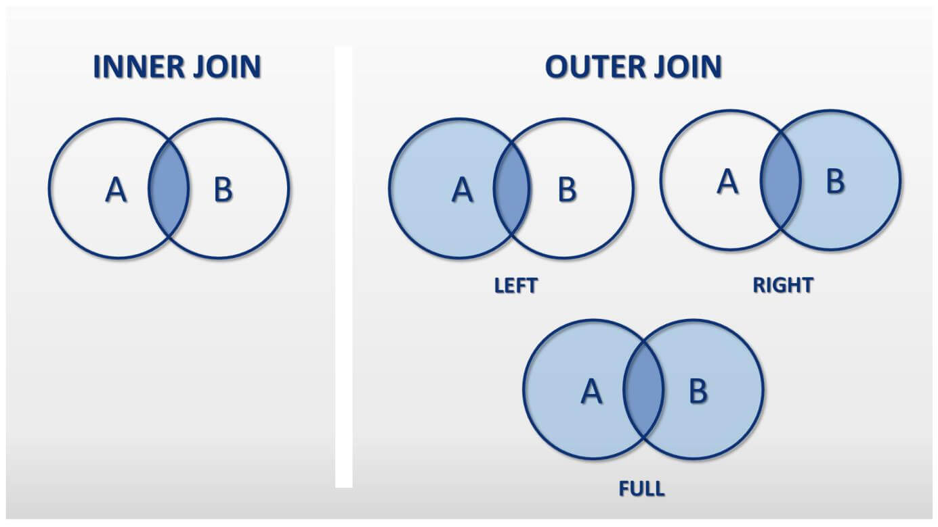
LEFT and RIGHT OUTER Joins
Table A would be the first table in your SELECT statement

Slide 23
LEFT and RIGHT OUTER Joins
In the example shown of a left outer join, note that the table name listed to the left of the words "left outer join" is referred to as the "left table."
SELECT e.last_name, d.department_id, d.department_name
FROM employees e LEFT OUTER JOIN departments d
ON (e.department_id = d.department_id);
LAST_NAME | DEPT_ID | DEPT_NAME
Vargas | 10 | Adminstration
Matos | 20 | Marketing
… | … | …
Rajs | 80 | Sales
Fay | 90 | Executive
Smith | - | -

Slide 24
LEFT and RIGHT OUTER Joins
This right outer join would return all department IDs and department names, both those that have employees assigned to them and those that do not.
SELECT e.last_name, d.department_id, d.department_name
FROM employees e RIGHT OUTER JOIN departments d
ON (e.department_id = d.department_id);
LAST_NAME | DEPT_ID | DEPT_NAME
Vargas | 10 | Adminstration
Matos | 20 | Marketing
… | … | …
Rajs | 80 | Sales
Fay | 90 | Executive
- | 190 | Contracting

Slide 25
FULL OUTER Join
It is possible to create a join condition to retrieve all matching rows and all unmatched rows from both tables.
Using a full outer join solves this problem.
The result set of a full outer join includes all rows from a left outer join and all rows from a right outer join combined together without duplication.

Slide 26
FULL OUTER Joins
The example shown is a full outer join.
SELECT e.last_name, d.department_id, d.department_name
FROM employees e FULL OUTER JOIN departments d
ON (e.department_id = d.department_id);
LAST_NAME | DEPT_ID | DEPT_NAME
Vargas | 10 | Adminstration
Matos | 20 | Marketing
… | … | …
Rajs | 80 | Sales
Fay | 90 | Executive
Smith | - | -
- | 190 | Contracting

Slide 27
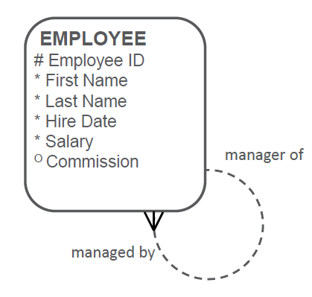
SELF Join
In data modeling, it was sometimes necessary to show an entity with a relationship to itself.
For example, an employee can also be a manager.
We showed this using the recursive or "pig's ear" relationship.

Slide 28
SELF Join
A self-join is use to join a table to itself as if it was two tables.
To join a table to itself, the table is given two names or aliases. This will make the database "think" that there are two tables.
Manager_id in the worker table is equal to employee_id in the manager table.
Employees(Worker)
Employees(Manager)
Choose alias names that relate to the data association.
employee_id | last_name | manager_id
100 | King
101 | Kochar | 100
102 | De Haan | 100
103 | Hunold | 102
104 | Ernst | 103
105 | Lorentz | 103
employee_id | last_name
100 | King
101 | Kochar
102 | De Haan
103 | Hunold
104 | Ernst
105 | Lorentz

Slide 29
SELF-JOIN Example
SELECT worker.last_name, worker.manager_id, manager.last_name
AS "Manager name"
FROM employees worker JOIN employees manager
ON (worker.manager_id = manager.employee_id);
Notice Join on the same table with two different aliases.
LAST_NAME | MANAGER_ID | Manager Name
Kochhar | 100 | King
De Haan | 100 | King
Zlotkey | 100 | King
Mourgos | 100 | King
Hartstein | 100 | King
Whalen | 100 | King
Higgins | 101 | Kochhar

Slide 30
Hierarchical Queries
Closely related to self-joins are hierarchical queries.
On the previous pages, you saw how you can use self-joins to see each employee's direct manager.
With hierarchical queries, we can also see who that manager works for, and so on.
With this type of query, we can build an Organization Chart showing the structure of a company or a department.

Slide 31
Hierarchical Queries
Imagine a family tree with the eldest members of the family found close to the base or trunk of the tree and the youngest members representing branches of the tree.
Branches can have their own branches, and so on.

Slide 32
Using Hierarchical Queries
Using hierarchical queries, you can retrieve data based on a natural hierarchical relationship between rows in a table.
A relational database does not store records in a hierarchical way.
However, where a hierarchical relationship exists between the rows of a single table, a process called tree walking enables the hierarchy to be constructed.
A hierarchical query is a method of reporting the branches of a tree in a specific order.

Slide 33
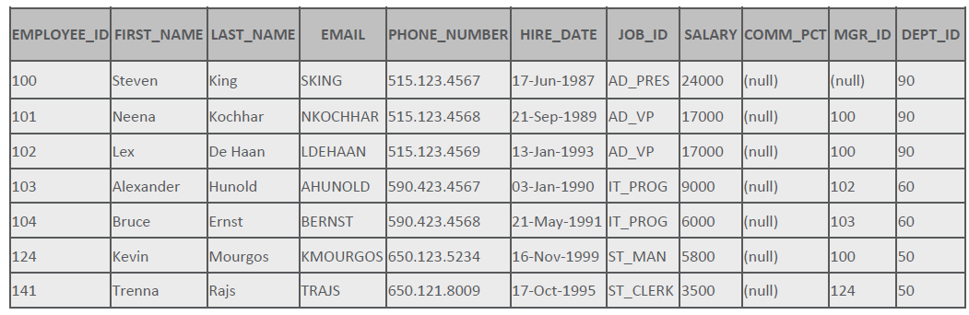
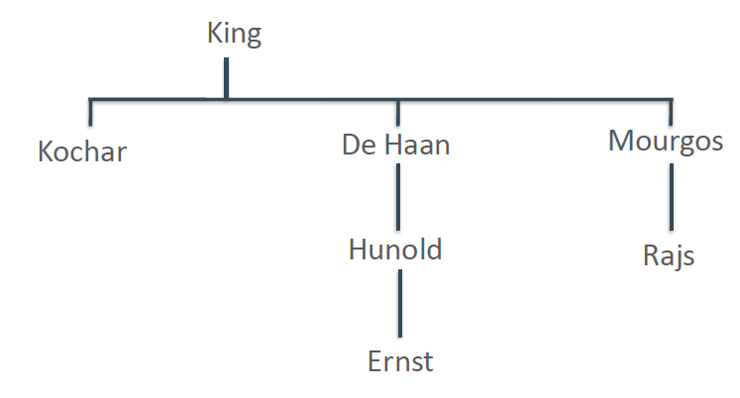
Hierarchical Queries Data
Examine the sample data from the EMPLOYEES table below, and look at how you can manually make the connections to see who works for whom starting with Steven King and moving through the tree from there.
Illustration of hierarchy of employees.

Slide 34
Hierarchical Queries Keywords
Hierarchical queries have their own new keywords: START WITH, CONNECT BY PRIOR, and LEVEL.
START WITH identifies which row to use as the Root for the tree it is constructing, CONNECT BY PRIOR explains how to do the inter-row joins, and LEVEL specifies how many branches deep the tree will traverse

Slide 35
Hierarchical Queries Keyword Example
SELECT employee_id, last_name, job_id, manager_id
FROM employees
START WITH employee_id = 100
CONNECT BY PRIOR employee_id = manager_id
EMPLOYEE_ID | LAST_NAME | JOB_ID | MANAGER_ID
100 | King | AD_PRES | -
101 | Kochhar | AD_VP | 100
200 | De Haan | AD_ASST | 101
205 | Zlotkey | AC_MGR | 101
206 | Mourgos | AC_ACCOUNT | 205
102 | Hartstein | AD_VP | 100
103 | Whalen | IT_PROG | 102

Slide 36
Hierarchical Queries Level Example
LEVEL is a pseudo-column used with hierarchical queries, and it counts the number of steps it has taken from the root of the tree.
SELECT LEVEL, last_name ||
' reports to ' ||
PRIOR last_name
AS "Walk Top Down"
FROM employees
START WITH last_name = 'King'
CONNECT BY PRIOR
employee_id = manager_id;
LEVEL | Walk Top Down
1 | King reports to
2 | Kochhar reports to King
3 | Whalen reports to Kochhar
3 | Higgins reports to Kochhar
4 | Gietz reports to Higgins
2 | De Haan reports to King
3 | Hunold reports to De Haan

Slide 37
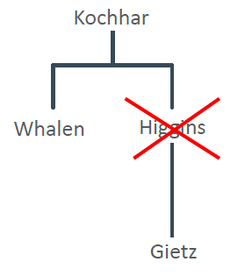
Hierarchical Queries Pruning
For example, if you want to exclude a single row from your result, you would use the WHERE clause to exclude that row; however, in the result, it would then look like Gietz worked directly for Kochhar, which he does not.
SELECT last_name
FROM employees
WHERE last_name!= 'Higgins'
START WITH last_name= 'Kochhar'
CONNECT BY PRIOR employee_id= manager_id;

Slide 38
Join Commands
Given the scope of this course is Oracle, we will focus on different types of JOIN syntax.
Oracle Proprietary Join | ANSI/ISO SQL: 1999 Equivalent
Cartesian Product | Cross Join
Equijoin | NATURAL JOIN JOIN USING clause JOIN ON clause (if the equality operator is used)
Non-equijoin | ON Clause

Slide 39
ORACLE Proprietary Joins
To query data from more than one table using the Oracle proprietary syntax, use a join condition in the WHERE clause.
The basic format of a join statement is:
This is called "qualifying your columns."
The combination of table name and column name helps eliminate ambiguous names when two tables contain a column with the same column name.
SELECT table1.column, table2.column
FROM table1, table2
WHERE table1.column1 = table2.column2;
Easier to read and speed up database access, preface the column name with the table name

Slide 40
EQUIJOIN
Sometimes called a "simple" or "inner" join, an equijoin is a table join that combines rows that have the same values for the specified columns.
An equijion is equavalent to ANSI:
NATURAL JOIN
JOIN USING
JOIN ON (when the join condition uses "=")
The next slide demonstrates the what, where and how required to join the tables.

Slide 41
EQUIJOIN
What? The SELECT clause specifies the column names to display.
Where? The FROM clause specifies the tables that the database must access, separated by commas.
How? The WHERE clause specifies how the tables are to be joined.
An Equijoin uses the equals operator to specify the join condition.

Slide 42
EQUIJOIN
SELECT employees.last_name, employees.job_id, jobs.job_title
FROM employees, jobs
WHERE employees.job_id = jobs.job_id;
What?
Where?
How?
LAST_NAME | JOB_ID | JOB_TITLE
King | AD_PRES | President
Kochhar | AD_VP | Administration Vice President
De Haan | AD_ASST | Administration Assistant
Zlotkey | AC_MGR | Accounting Manager
Mourgos | AC_ACCOUNT | Public Accountant
Hartstein | AD_VP | Administration Vice President
Whalen | IT_PROG | IT Program Head

Slide 43
Cartesian Product Join
If two tables in a join query have no join condition specified in the WHERE clause or the join condition is invalid, the Oracle Server returns the Cartesian product of the two tables.
This is a combination of each row of one table with each row of the other.
A Cartesian product is equivalent to an ANSI CROSS JOIN.
To avoid a Cartesian product, always include a valid join condition in a WHERE clause.

Slide 44
Cartesian Product Join
In this query, the join condition has been omitted:
SELECT employees.last_name, departments.department_name
FROM employees, departments;
LAST_NAME | DEPARTMENT_NAME
Abel | Administration
Davies | Administration
De Haan | Administration
Ernst | Administration
Fay | Administration
Gietz | Administration
…

Slide 45
Restricting Rows in a Join
As with single-table queries, the WHERE clause can be used to restrict the rows considered in one or more tables of the join.
The query shown uses the AND operator to restrict the rows returned.
SELECT employees.last_name, employees.job_id, jobs.job_title
FROM employees, jobs
WHERE employees.job_id = jobs.job_id
AND employees.department_id = 80;
LAST_NAME | JOB_ID | JOB_TITLE
Abel | SA_MAN | Sales Manager
Davies | SA_REP | Sales Representative
De Haan | SA_REP | Sales Representative

Slide 46
Nonequijoin
Example:
Suppose we want to know the grade_level for each employee's salary.
The job_grades table does not have a common column with the employees table.
Using a nonequijoin allows us to join the two tables.
GRADE_LEVEL | LOWEST_SAL | HIGHEST_SAL
A | 1000 | 2999
B | 3000 | 5999
C | 6000 | 9999
D | 10000 | 14999
E | 15000 | 24999
F | 25000 | 40000

Slide 47
Nonequijoin
Since there is no exact match between the two columns in each table, the equality operator = can't be used.
Although comparison conditions such as <= and >= can be used, BETWEEN...AND is a more effective way to execute a nonequijoin.
A nonequijoin is equivalent to an ANSI JOIN ON (where the condition used is something other than equals).

Slide 48
Nonequijoin
SELECT last_name, salary, grade_level, lowest_sal, highest_sal
FROM employees, job_grades
WHERE (salary BETWEEN lowest_sal AND highest_sal);
LAST_NAME | SALARY | GRADE_LEVEL | LOWEST_SAL | HIGHEST_SAL
Vargas | 2500 | A | 1000 | 2999
Matos | 2600 | A | 1000 | 2999
Davies | 3100 | B | 3000 | 5999
Rajs | 3500 | B | 3000 | 5999
Lorentz | 4200 | B | 3000 | 5999
Whalen | 4400 | B | 3000 | 5999
… | … | … | … | …

Slide 49
Outer Join
An outer join is used to see rows that have a corresponding value in another table plus those rows in one of the tables that have no matching value in the other table.
To indicate which table may have missing data using Oracle Join Syntax, add a plus sign (+) after the table's column name in the WHERE clause of the query.

Slide 50
Outer Join
This query will return all employee last names, including those that are assigned to a department and those that are not.
The same results could be obtained using an ANSI LEFT OUTER JOIN.
SELECT e.last_name, d.department_id,
d.department_name
FROM employees e, departments d
WHERE e.department_id =
d.department_id(+);
LAST_NAME | DEPT_ID | DEPT_NAME
Vargas | 10 | Adminstration
Matos | 20 | Marketing
… | … | …
Rajs | 80 | Sales
Fay | 90 | Executive
Smith | - | -

Slide 51
Outer Join
This outer join would return all department IDs and department names, both those that have employees assigned to them and those that do not.
The same results could be obtained using an ANSI RIGHT OUTER JOIN.
SELECT e.last_name, d.department_id,
d.department_name
FROM employees e, departments d
WHERE e.department_id (+) =
d.department_id;
LAST_NAME | DEPT_ID | DEPT_NAME
Vargas | 10 | Adminstration
Matos | 20 | Marketing
… | … | …
Rajs | 80 | Sales
Fay | 90 | Executive
- | 190 | Contracting

Slide 52
Outer Join
It is not possible to have the equivalent of a FULL OUTER JOIN by adding a (+) sign to both columns in the join condition.
Attempting this results in an error.
SELECT e.last_name, d.department_id, d.department_name
FROM employees e, departments d
WHERE e.department_id(+) = d.department_id(+);

Slide 53
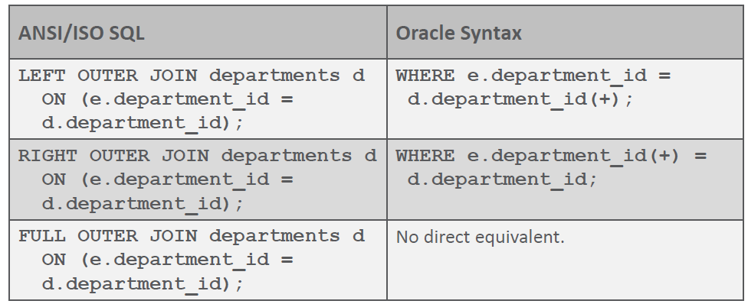
Outer Join and ANIS Equivalents
The table below shows ANSI/ISO SQL: 99 joins and their equivalent Oracle outer joins.

